Slide 1
Phase 5: Defining the Sketch of the Solving Methodology
Supervised by
Dr. Sabah Mohammad
Presented by:
Revanth Yenugudhati
1111423

Slide 2
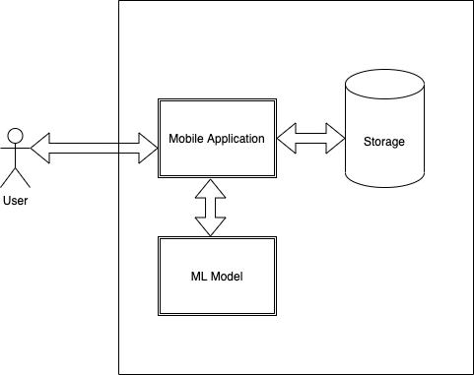
System Architecture:
Notes:
This is my application

Slide 3
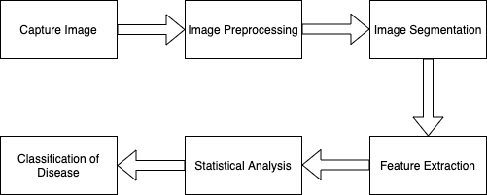
Flow Diagram:

Slide 4
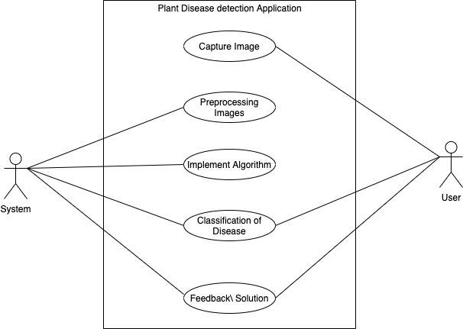
Use Case Diagram

Slide 5
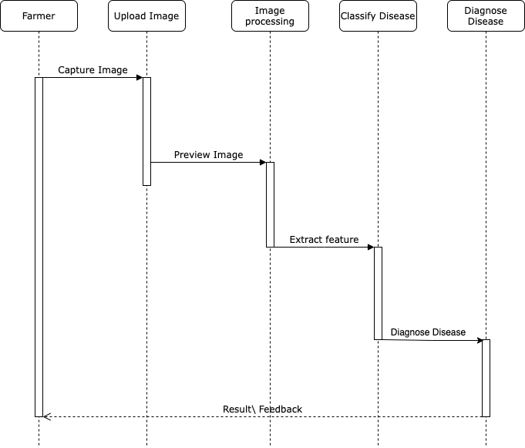
Sequence Diagram

Slide 6
Thank You!!!

